Slide 1

Guidelines
Kindly use the given template for submitting your project (Make a copy of the template)
One team is only required to submit one project/ppt.
The ideal size of the presentation should not be more than 10 slides.
You are welcome to add as many POCs and design concepts to support your project.
The project should be feasible and the team members should be capable enough, to come up with the prototype of the same idea, if required.
Solutions must include at least one Google technology.

Slide 2

Team Details
Team name:
Team leader name:
Problem Statement: Open Innovation

Slide 3
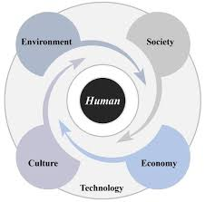
1. Introduction: A Sustainable Smart City is an urban area that uses modern technologies along with eco-friendly practices to improve the quality of life of people. It focuses on efficient use of energy, water, transportation, and waste management while reducing pollution and environmental impact.
Found

Slide 4
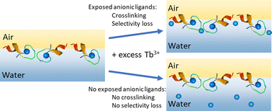
2. Need for Sustainable Smart Cities
Due to rapid urbanization, cities face many problems such as:
* Traffic congestion
* Air and water pollution
* High energy consumption
* Poor waste management
* Water scarcity
Sustainable smart cities help solve these issues using technology and smart planning.

Slide 5
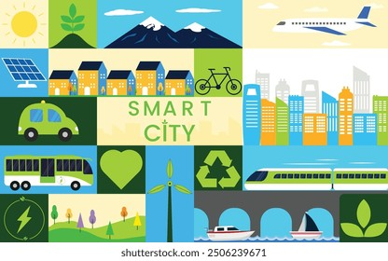
3. Definition of sustainable smart cities:
A Sustainable Smart City integrates Information and Communication Technology (ICT) with sustainable infrastructure to optimize city operations, reduce environmental impact, and provide better services to citizens.

Slide 6
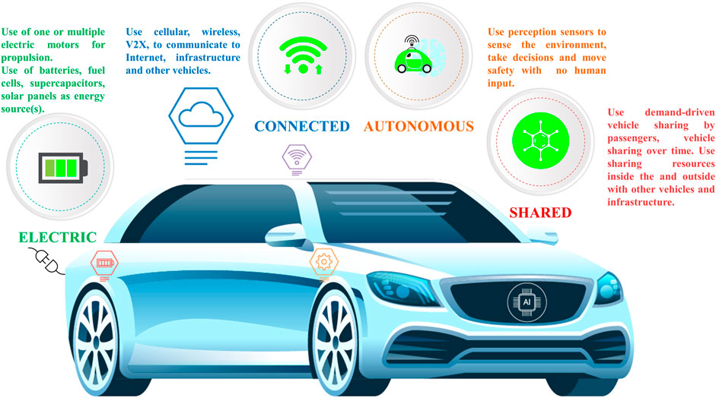
4. Technologies Used:
* Internet of Things (IoT)
* Artificial Intelligence (AI)
* Big Data Analytics
* Cloud Computing
* Geographic Information Systems (GIS)
This Photo by Unknown Author is licensed under CC BY

Slide 7
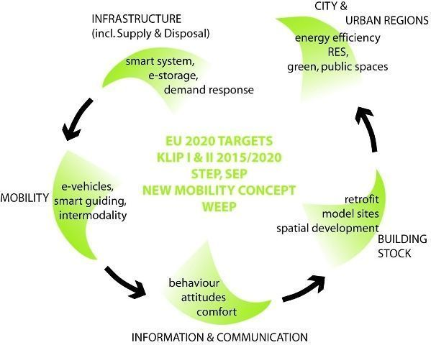
5. Working of a Smart City (Diagram)
Sensors & Devices
↓
Data Collection
↓
Cloud Storage
↓
AI & Analytics
↓
Smart City Services

Slide 8
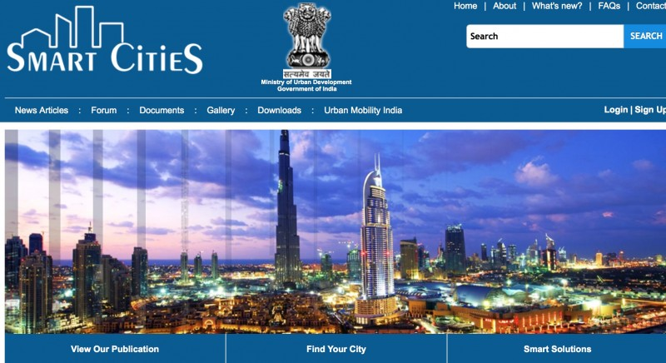
Wireframes/Mock diagrams of the proposed solution (optional)

Slide 9
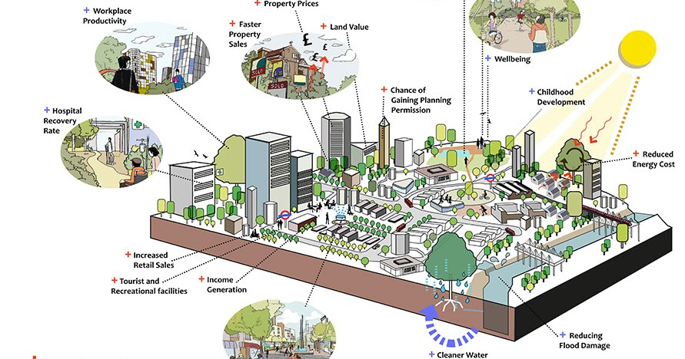
6. ARCHITECTURE DIAGRAM OF SUSTAINABLE SMART CITIES

Slide 10
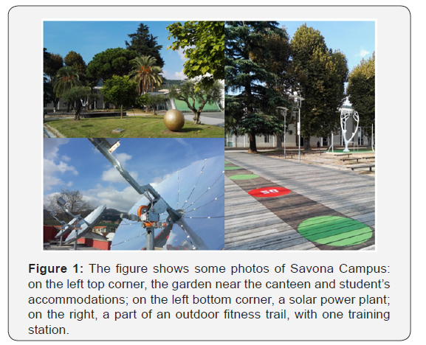
7. Architecture of the MVP of the sustainable smart cities

Slide 11
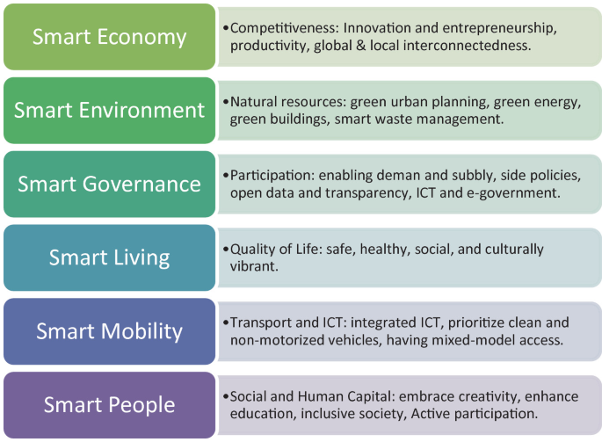
8. Future Scope:
Future sustainable smart cities aim to:
Become carbon-neutral
Use AI-based urban planning
Implement digital twin technology
Use 100% renewable energy

Slide 12
Provide links to your:
GitHub Public Repository
Demo Video Link (3 Minutes)
MVP Link

Slide 13
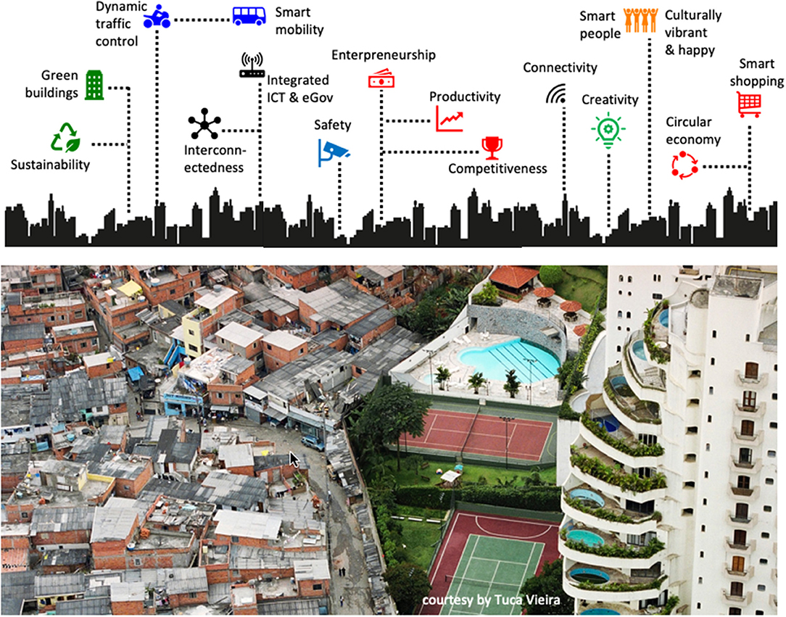
7. Benefits of smart cities:
Reduced pollution and carbon emissions
Efficient use of resources
Improved transportation
Better healthcare and safety
Improved quality of life
8. Applications of the smart cities:
Smart traffic control
Smart street lighting
Smart parking systems
Waste monitoring systems
Digital healthcare
E-governance services

Slide 14
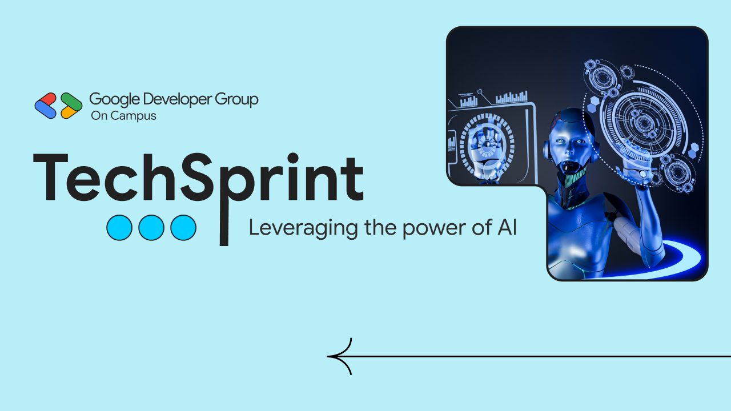
Thank you!

